Slide 1



Unit-7 large signal amplifier
Large signal amplifiers also known as power amplifiers are capable of providing large amount of power to the load. They are used as last stage in electronic systems. A power amplifier takes the d.c. power supply connected to the output circuit and converts it into a.c. signal power.

Slide 2

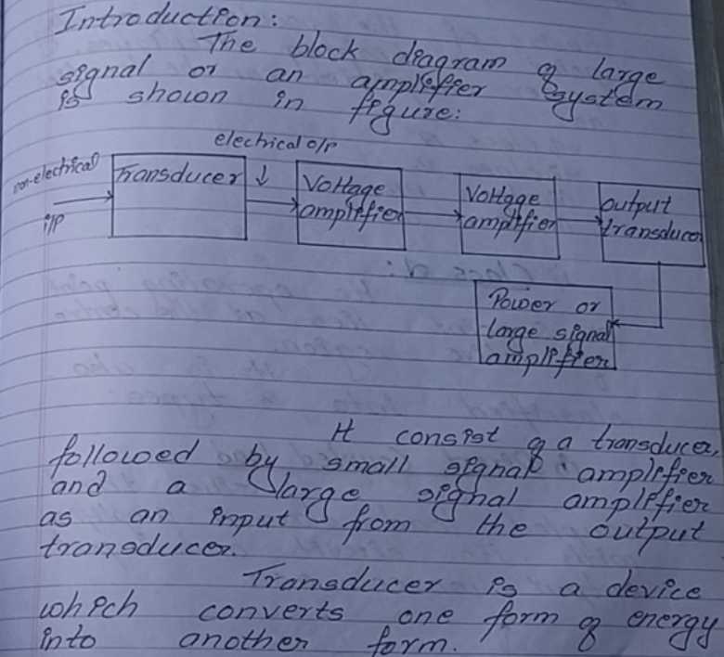
Introduction

Slide 3
Types of power Amplifier
Class A: In this class operation, amplified output is achieved for the entire input signal. In order to have a distortion less amplified signal at the output, class A power amplifiers are used. It is sometimes termed as inefficient operation as power conversion from dc to ac at the output is somewhat low.
Class B: Using this class of transistors in which equal but opposite magnitude of the input signal is fed. Therefore, by employing two transistors we can have complete amplified signal at the output.
In this class of operation, a zero crossing error is introduced that is also known as crossover distortion. To have a detailed idea about crossover distortion you can also refer Power amplifiers.
Class AB: A combined operation of class A and B resultantly provides class AB operation. It was basically introduced to overcome the disadvantage of Class B operation. Class AB conducts for more than 180⁰ but less than 360⁰ of the input signal cycle.
Class C: This class is basically used when there is a need to operate at a fixed frequency. It provides output for less than half cycle of input and is highly efficient but is not suitable for audio amplification purposes.
operation, the output is achieved only for the positive half of the input signal. However, it employs two complementary

Slide 4
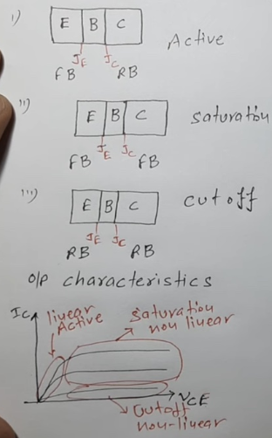
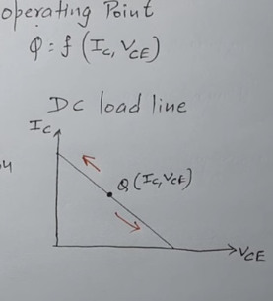
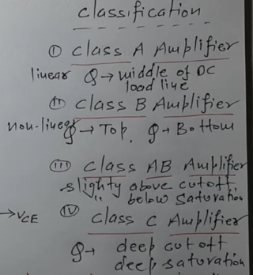

WORKING of power amplifier
Basic concept
Operating point
classification

Slide 5
CLASS-A POWER AMPLIFIER
In Class A amplifier, If the collector current flows all times during the full cycle of the input signal, the power amplifier is known as class A power amplifier. It is less used for higher power output stages, as it has poor efficiency.
The purpose of the class A bias is to make the amplifier relatively free from noise by making the signal waveform out of the region between 0v to 0.6v where the transistor’s input characteristic is non-linear.
Class A amplifier design produces a good linear amplifier, but most of the power produced by the amplifier goes wastage in the form of heat. Since the transistors in Class A amplifier, are forward biased all the time, few current will flow through them even though there is no input signal and this is the main reason for its poor efficiency.

Slide 6
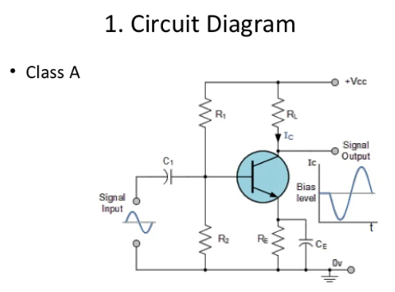
Q-Point is in the center of loadline bjt amplifier is in active region
Case-I:
If V_{in} is positive(+) half cycle, then
I_{B}↑ I_{C} ↑
I_{C} = βI_{B} ⇒ I_{C} ↑
Decrease in V_{CE} = V_{CC} – ↑I_{C} R_{C}
CASE-II
If V_{in} is negative(-) cycle then,
I_{B} decreases and I_{C} decreases.
↑V_{CE} = V_{CC} – I_{C}R_{C} ↓

Slide 7
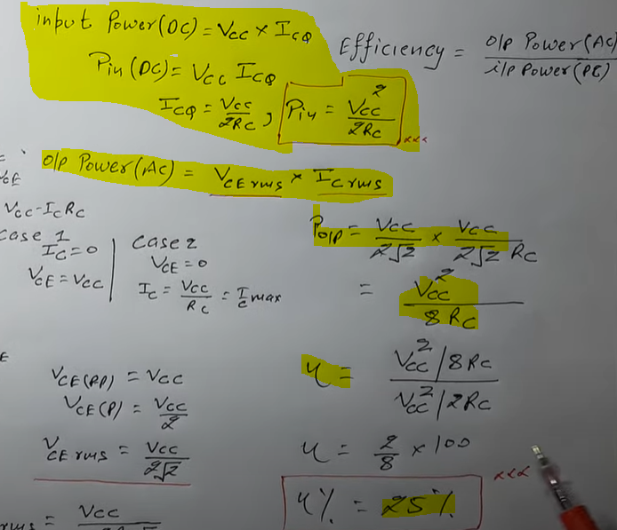
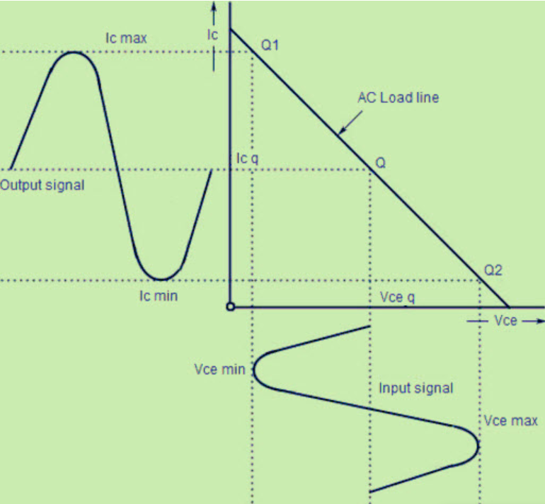
Output result

Slide 8
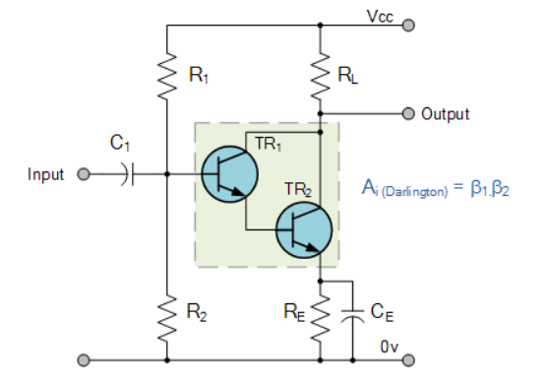
The efficiency of this type of circuit is very low (less than 30%) and delivers small power outputs for a large drain on the DC power supply. A Class A amplifier stage passes the same load current even when no input signal is applied so large heatsinks are needed for the output transistors.
However, another simple way to increase the current handling capacity of the circuit while at the same time obtain a greater power gain is to replace the single output transistor with a Darlington Transistor. These types of devices are basically two transistors within a single package, one small “pilot” transistor and another larger “switching” transistor. The big advantage of these devices are that the input impedance is suitably large while the output impedance is relatively low, thereby reducing the power loss and therefore the heat within the switching device.
The overall current gain Beta (β) or hfe value of a Darlington device is the product of the two individual gains of the transistors multiplied together and very high β values along with high Collector currents are possible compared to a single transistor circuit.

Slide 9
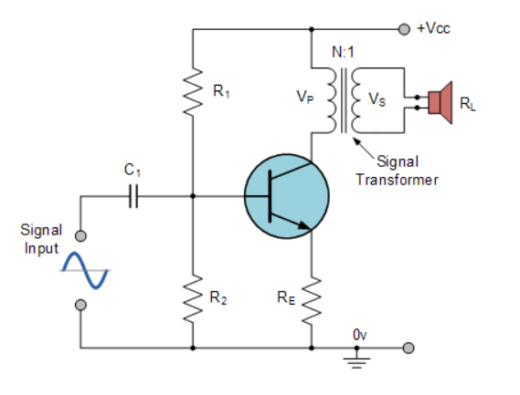
To improve the full power efficiency of the Class A amplifier it is possible to design the circuit with a transformer connected directly in the Collector circuit to form a circuit called a Transformer Coupled Amplifier. The transformer improves the efficiency of the amplifier by matching the impedance of the load with that of the amplifiers output using the turns ratio ( n ) of the transformer and an example of this is given below.
As the Collector current, Ic is reduced to below the quiescent Q-point set up by the base bias voltage, due to variations in the base current, the magnetic flux in the transformer core collapses causing an induced emf in the transformer primary windings. This causes an instantaneous collector voltage to rise to a value of twice the supply voltage 2Vcc giving a maximum collector current of twice Ic when the Collector voltage is at its minimum. Then the efficiency of this type of Class A amplifier configuration can be calculated as follows

Slide 10
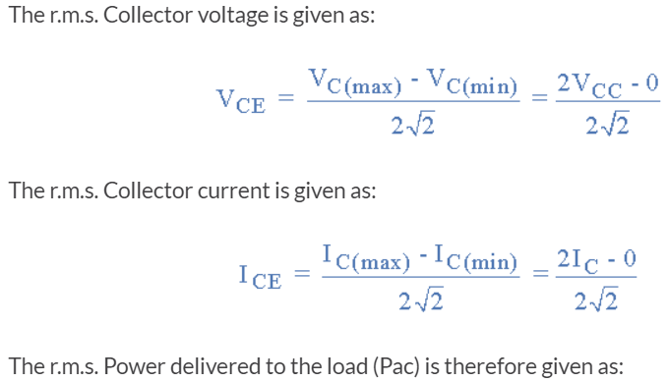
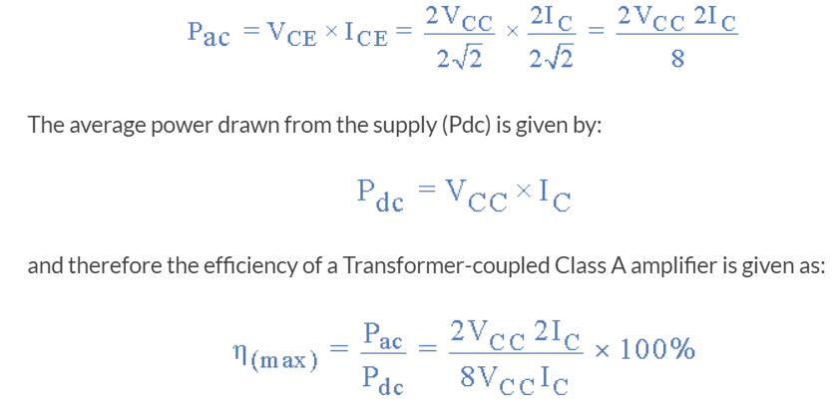
An output transformer improves the efficiency of the amplifier by matching the impedance of the load with that of the amplifiers output impedance. By using an output or signal transformer with a suitable turns ratio, class-A amplifier efficiencies reaching 40% are possible with most commercially available Class-A type power amplifiers being of this type of configuration.
Disadvantage of this type of transformer coupled class A amplifier circuit is the additional cost and size of the audio transformer required.

Slide 11
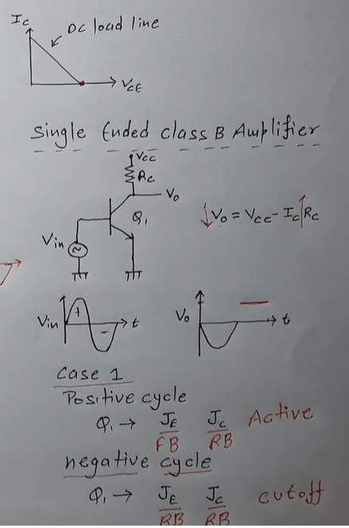
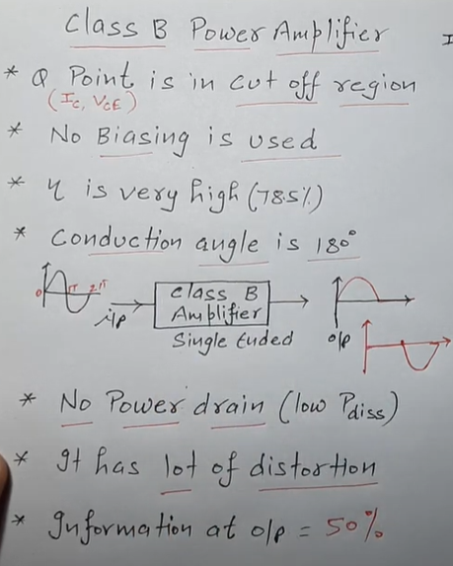
Class b Amplifier- Operation has zero DC bias as the transistors are biased at the cut-off, so each transistor only conducts when the input signal is greater than the Base-emitter voltage.

Slide 12
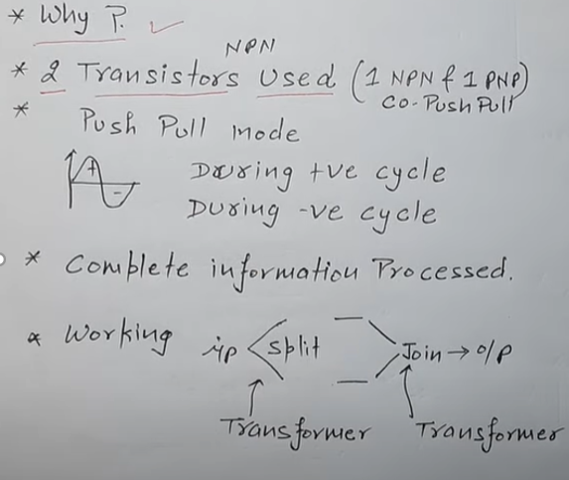
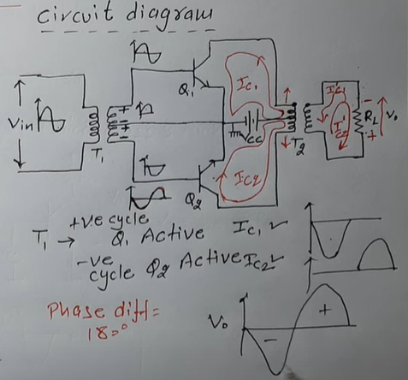
Push-pull class b Amplifier (we user transformer coupled push pull class b amplifier)

Slide 13
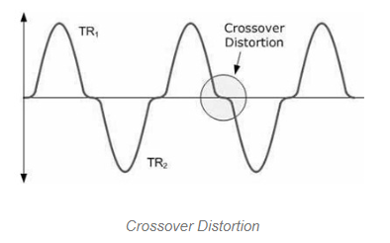
Cross Over Distortion
Whenever the transistors start conduction just after the amplitude of the input signal has increased above 0.7V, then the input signal regions where the amplitude is below 0.7V will be not there with the output signal, known as cross-over distortion. The cross-over distortion waveform is shown below. So in this diagram, you can notice that the input waveform regions which are below 0.7V are not there within the o/p waveform.

Slide 14
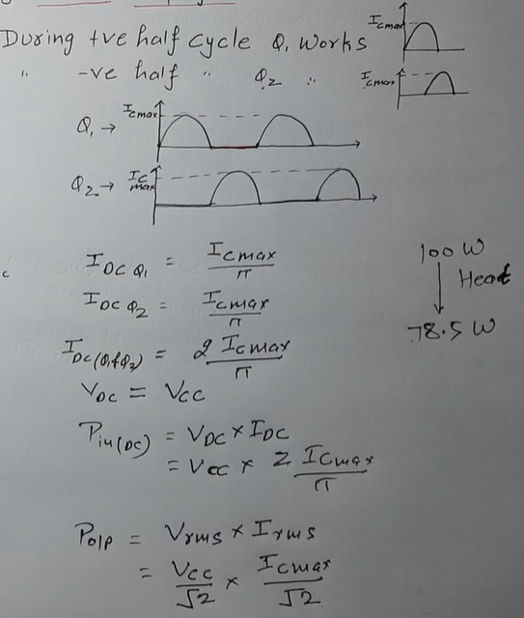
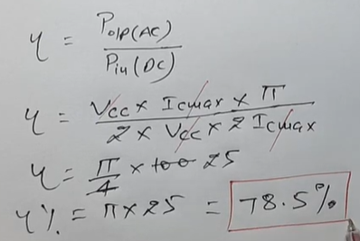
Calculation of efficiency of class b amplifier

Slide 15
Class ab amplifier- Class AB amplifier output stage combines the advantages of the Class A amplifier and the Class B amplifier producing a better amplifier design
ASSIGNMENT

Slide 16
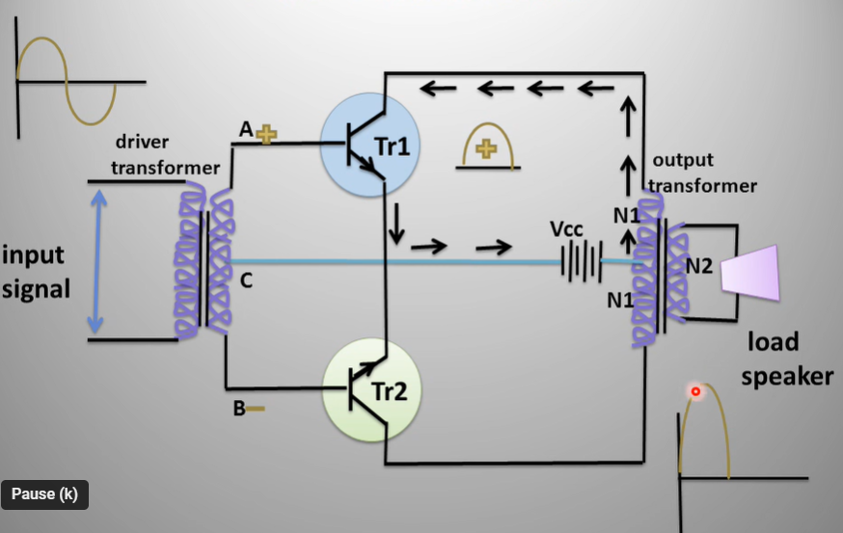
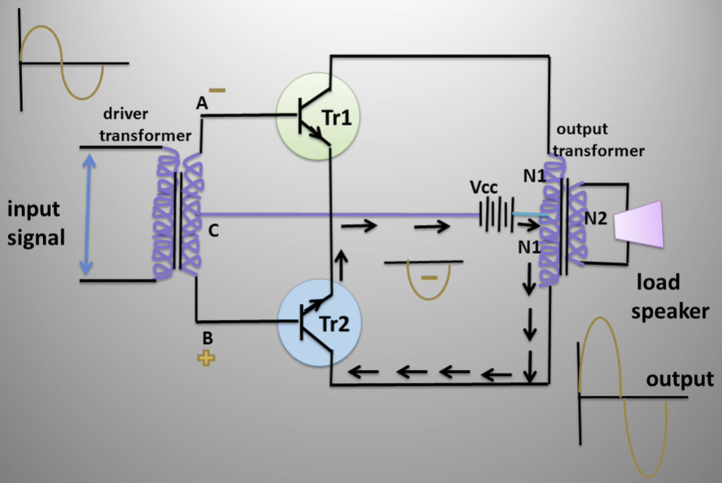
Push-pull amplifier

Slide 17
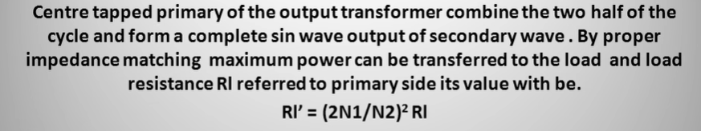
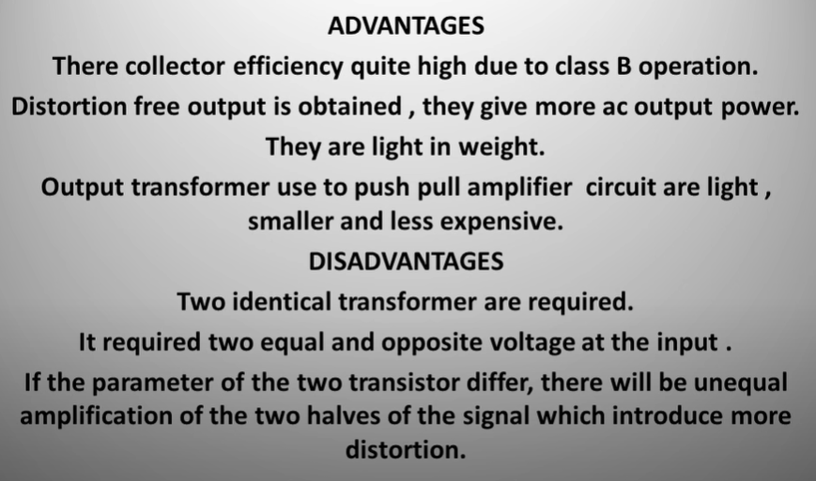

Slide 18
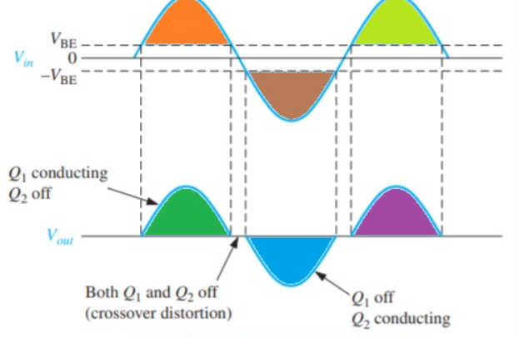
Crossover distortion- distortion occurring where a signal changes from positive to negative or vice versa.
If the value of dc biased voltage is 0 both transistor are not on and input signal voltage should be larger than VBE before the transistor conduction.
Due to this, there is time interval among the positive and negative variation of input when there is no transistor is operating as shown in below figure

